Slide 1

Data Communications
Spring, 2020
School of Computer Science and Engineering
Pusan National University
Jeong Goo Kim

Slide 2
Course Information
Class Day/Time: Tuesday, Thursday / 13:30
Classroom: Engineering Bldg. #6, Room 6202
Instructor: Jeong Goo Kim
  Office: Research & Lab. Bldg. #1, Room 420
  Phone: 510-3733
  E-mail: kimjg@pusan.ac.kr
Office Hours: Tuesday, Thursday 16:50 – 17:50
Homework: Due one week from day assigned (unless otherwise specified)
Grading: Attendance: 10 % Homework: 25%
Final Exam: 30% Mid Term Exam: 30%
Presentation: 5%

Slide 3
Course Information
Course Objectives
  Study on data transmission principle, transmission media and data encoding
  Study on data link control, multiplexing, and Interfacing
  Study on circuit switching, packet switching , and routing
  Study on local area network and wireless LAN
TEXT
  Behrouz A. Forouzan, Data Communications and Networking(10E), McGraw Hill, 2014
  또는 이재광옮김, 데이터 통신, 제3판, , 맥그로힐에듀케이션코리아 유한회사, 2017
Useful References (Books):
  W. Stallings, Data and Computer Communications(8E), Prentice Hall
  A. Tannenbaum, Computer Networks(4E), Prentice-Hall, 2003
  이정태 외, 컴퓨터 네트워크 소프트웨어 및 시스템(3E), 사이텍미디어, 2004
All the information on this class will be posted at
abclab: https://abc.pusan.ac.kr, PLATO: https://plato.pusan.ac.kr

Slide 4
Class Schedule
Clas Schedule
Week | Contents | Note
1 | Introduction
2 | Network Models
3 | Introduction to Physical Layer | HW Assignment #1
4 | Digital and Analog Transmission
5 | Bandwidth Utilization: Multiplexing and Spectrum Spreading
6 | Transmission Media, Switching | HW Assignment #2
7 | Introduction to Data Link Layer
8 | Midterm Exam.
9 | Error Detection and Correction
10 | Data Link Control, Media Access Control
11 | Wired LANs: Ethernet | HW Assignment #3
12 | Other Wired Networks
13 | Wireless LANs
14 | Other Wireless Networks | HW Assignment #4
15 | Final Exam.
Note: Schedule may be changed according to the progress of classwork with notification

Slide 5
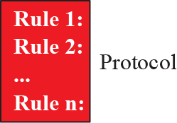
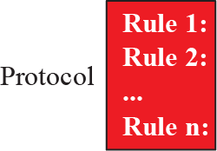



Data Communications
Data Communications

Slide 6
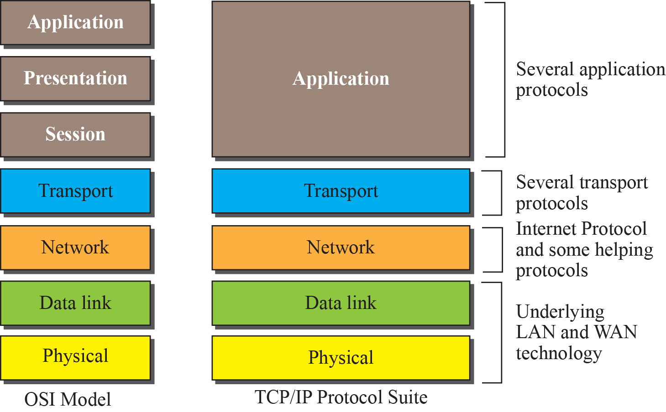
Data Communications
OSI Model and TCP/IP Protocol

Slide 7
Presentation subject
Presentation
Presentation method
  5 minutes speech
Topic
  Computer
  Data
  Communication
  Network
  Other related on data communication
Subtopic
  Figure
  History
  Technology
  Future
  And so on…

Slide 8
Homework and Next Lecture
Homework
  Read text book pp. 3-27
Next Lecture
  Chapter 1. Introduction

